Slide 1

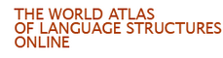
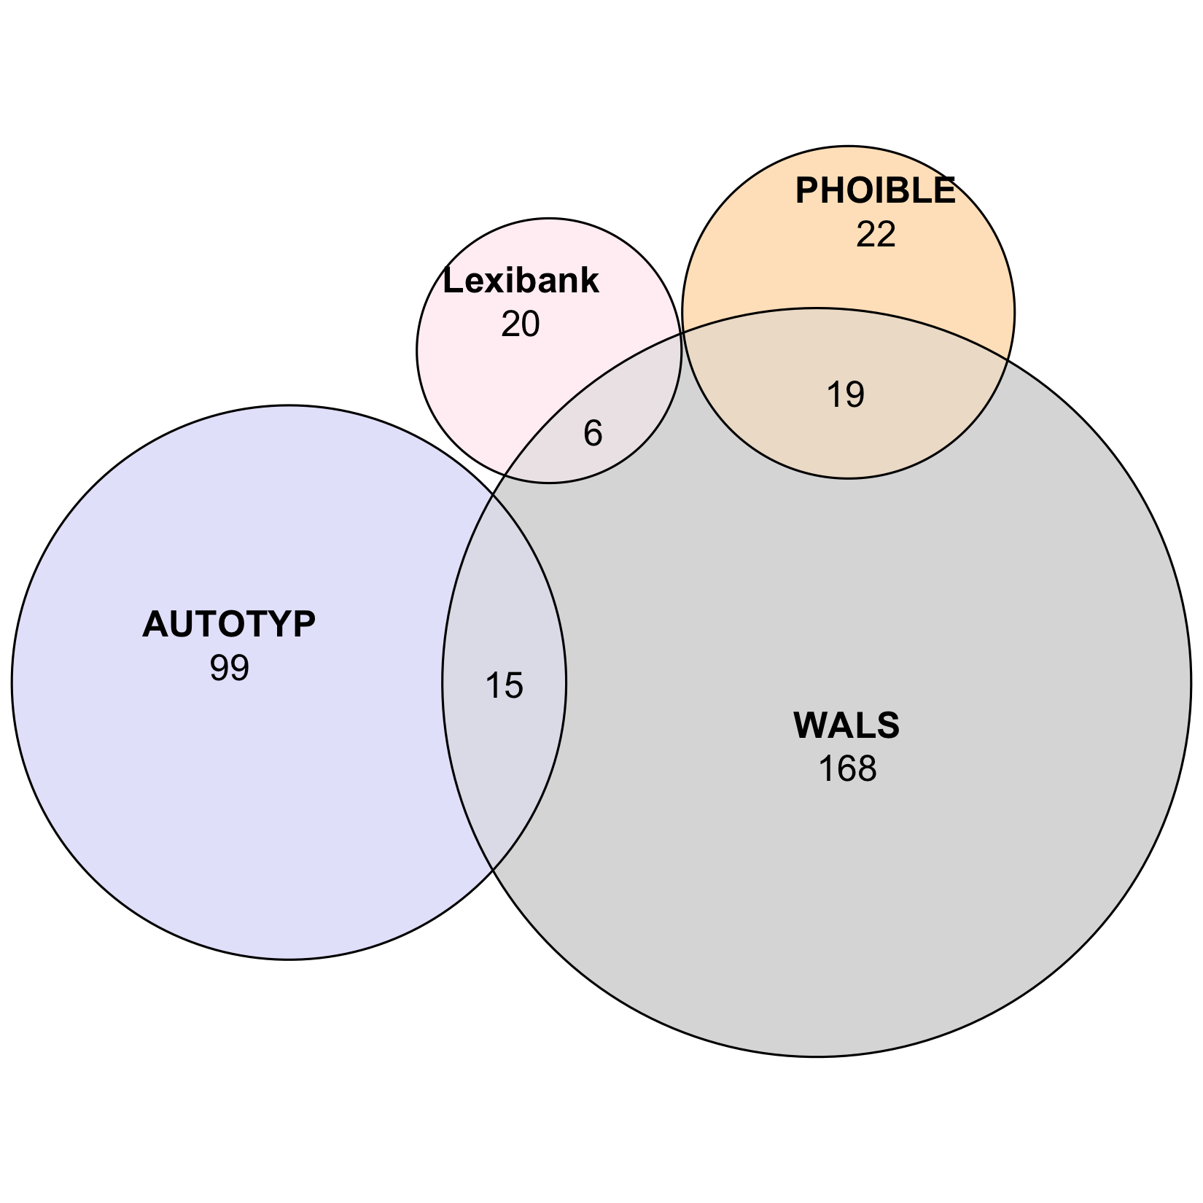
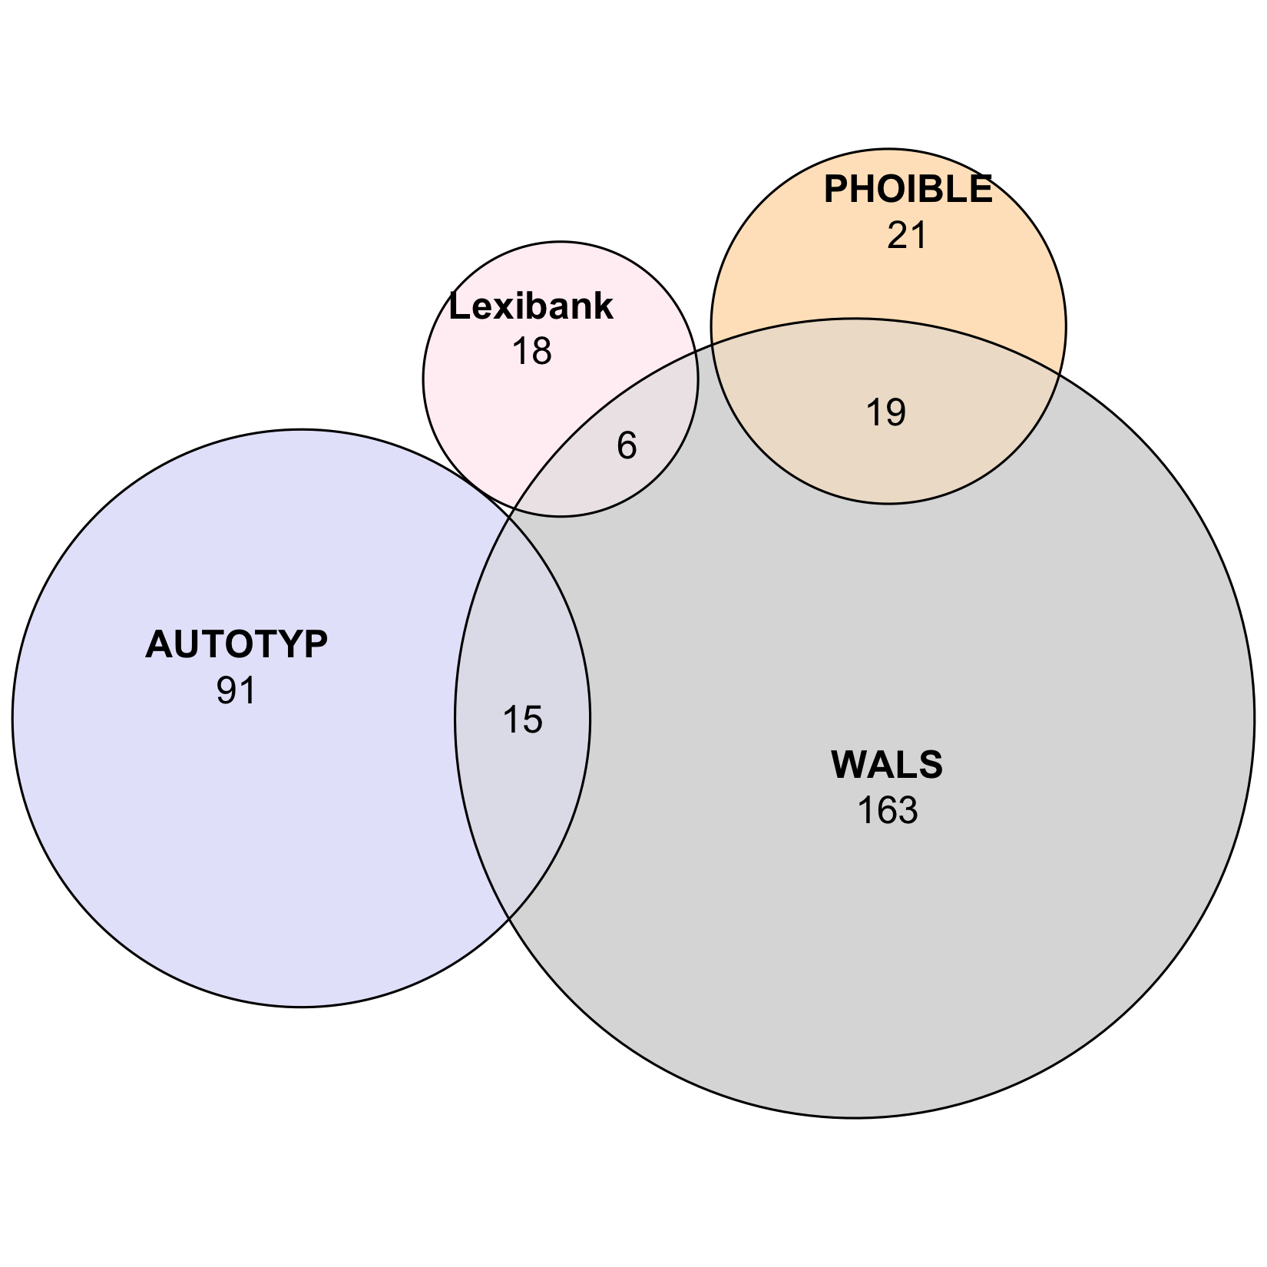


GBI logical,
pruned:
190 features
1,223 languages
GBI statistical,
pruned:
181 features
1,140 languages
A. GBI
densify
densify
Step 1
feature design +
logical independence
Step 2
statistical independence
Grambank:
195 features
2,467 languages
GBI logical:
203 features
2,467 languages
GBI statistical:
196 features
2,467 languages
95 retentions
100 exclusions
108 merges/modifications
157 retentions
46 exclusions
39 merges/modifications
inputs
curated outputs
WALS:
192 features
2,501 languages
Step 1
feature design +
logical independence
Step 2
statistical independence
TLI logical:
349 features
4,259 languages
TLI statistical:
333 features
4,257 languages
102 retentions
736 exclusions
247 merges/modifications
300 retentions
49 exclusions
33 merges/modifications
AUTOTYP
AUTOTYP:
545 features
1,126 languages
Lexibank:
60 features
2,029 languages
PHOIBLE:
41 features
2,176 languages
densify
densify
densify
densify
B. TLI
TLI logical,
pruned, large:
344 features
1,677 languages
TLI logical,
pruned, small:
335 features
555 languages
TLI statistical,
pruned, large:
328 features
1,696 languages
TLI statistical,
pruned, small:
321 features
644 languages

